Slide 1

Substitutable Medical Apps & Reusable Technology
Prepared By: Ohm Trivedi
Mentored By: Prof. Ravi Shankar

Slide 2
Contents
Objective
Vision
Funding
Introduction
SMART vs. Existing Systems
Substitutability
SMART Vocabulary
Data models, coding, and normalization
SMART API
Authentication and Authorization
User-interface apps
Background apps
Sample SMART apps
References

Slide 3
Objective
To develop a Health IT platform with substitutable applications (apps) constructed around core services.
Analogous to smartphone platforms such as iPhone or Android, which lower the barrier to app development
Substitutable Apps – Apps that can be added or deleted
Core Services – With reference to a smartphone, camera, calendar, address book, geo-location and cell and wireless networks
To give app developers tools to build substitutable apps

Slide 4
Vision
Drive down healthcare costs
Support standards evolution
Accommodate differences in care workﬂow
Foster competition in the market
Accelerate innovation

Slide 5
Funding
SMART is funded by the Office of the National Coordinator for Health Information Technology (ONC) through the Strategic Health IT Advanced Research Projects (SHARP) program.

Slide 6

Introduction
The SMART team has focused on enabling the property of substitutability through an app programming interface leveraging web standards, presenting predictable data payloads, and abstracting away many details of enterprise health information technology systems.

Slide 7
SMART vs. Existing Systems
This model stands in stark contrast with the largely monolithic and slow-to-evolve health information systems that have been designed and implemented to date, where one size has to ﬁt most providers, customization is arduous and expensive, and only the few established EHR vendor developers can innovate.

Slide 8
Substitutability
The principle of substitutability is the central focus of the SMART Platforms project.
By deﬁning an app programming interface (API) that consistently presents well-speciﬁed data, we seek to
enable purchasers, users, and administrators of platform-based systems to be able to install and subsequently substitute apps from different vendors without software programming
create a broad market for app developers across multiple systems, including EHRs, PCHRs, and health information exchanges.

Slide 9
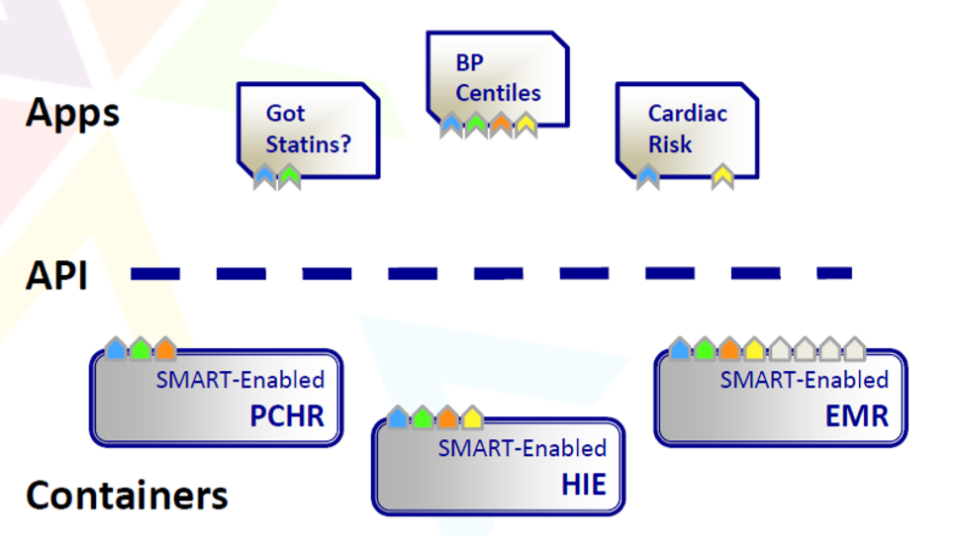
SMART Vocabulary

Slide 10
Apps: An app is an individual unit of functionality. A SMART app can run on top of any SMART system.
Containers: A container holds data. Containers - health information technology systems, such as electronic health records (EHR), personally controlled health records, and health information exchanges that use the SMART app programming interface or a portion of it - marshal data sources and present data simply, reliably, and consistently to apps. Containers can be “SMART-enabled” which makes them capable of running SMART apps.
API: An API is the language through which apps talk to the platform. The SMART API is the language through which SMART apps talk to SMART-enabled containers.

Slide 11
Data models, coding, and normalization
Practically, substitutability needs ‘semantic interoperability’ between apps and containers.
To achieve this interoperability, SMART deﬁnes a highly normalized abstraction of a medical record that is designed to be intuitive and easy to learn.
Key features:
developers work directly with concrete types such as allergy, medication, or problem, not abstract types such as entity, actor, or role;
the SMART speciﬁcation is ‘dogmatic’ making beforehand choices about how data are represented so that developers know what to expect. For instance, every problem in a SMART record is associated with a SNOMED CT4 disorder code;
SMART deﬁnes a limited set of broadly applicable data types, rather than permitting a proliferation of interface-speciﬁc deﬁnitions.

Slide 12
SMART represents a medical record as a series of statements or ‘triples’ according to the Resource Description Framework.
Multiple statements together form a ‘graph’ of patient data.
The meaning of each element in this graph is precisely deﬁned by the SMART ontology in OWL2 DL, a web standard for representing knowledge based on formal description logics.

Slide 13
SMART API
The current version of the SMART API provides a read-only view of the patient record.
An app can access the API through two distinct routes: SMART Connect and SMART REST.
SMART Connect is a browser-based JavaScript interface designed to offer a lightweight approach for developers building apps with rich client-side functionality.
SMART REST provides a representation state transfer interface to the medical record, allowing an app’s backend component to communicate directly with a container.
Regardless of whether data are accessed through SMART Connect or SMART REST, the set of API calls and payload formats are the same.

Slide 14
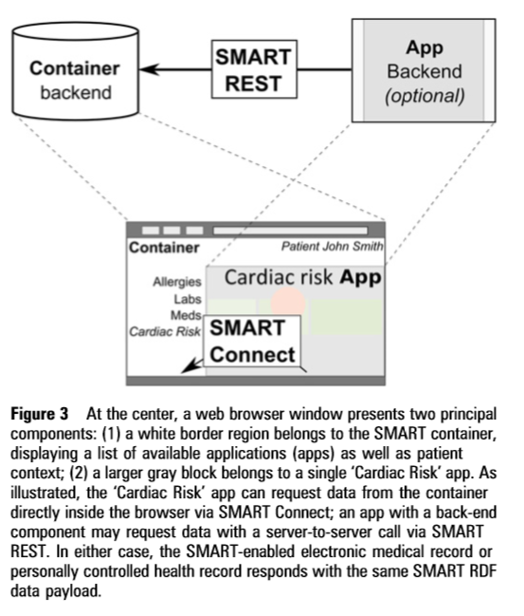

Slide 15
Each patient, and each clinical statement about that patient, is represented as a resource with a URI.
The structure of these URIs is speciﬁed with respect to a container’s ‘base URI’.
For example, a public SMART sandbox container is hosted with the base URI: http://sandbox-api.smartplatforms. org/.
An individual patient in the sandbox might be identiﬁed by: <http://sandboxapi.smartplatforms.org/records/123>.
A single medication on that patient’s medication list is represented as: <http://sandboxapi.smartplatforms.org/records/123/medications/456>.

Slide 16
Authentication and Authorization
To allow a single app to run against heterogeneous systems, the SMART speciﬁcation standardizes the authentication of API access but allows an underlying container to apply its own authorization mechanisms.
This means that, when an app makes an API call, the container can be certain that the call has not been forged.
But the container retains full power to determine whether the app is, in fact, authorized to retrieve the data it has requested.
Two authentication schemes are employed, one for SMART Connect and one for SMART REST calls.

Slide 17
User-interface apps
SMART user-interface apps are user-facing, browser-based apps written as HTML5 web apps, which are platform-independent and run in all modern web browsers on desktops or mobile devices.
They integrate into an existing health IT system via the HTML inline-frame element.

Slide 18
Background apps
Background apps employ the same API calls as user-interface apps but perform data processing and analysis without the need for user interaction.

Slide 19
Sample SMART apps
Got Statins: This app connects to the SMART client library, gets a medication list, and checks each one to determine if it is in a known list of statin drugs. It is a simple app with just 51 lines of html and java script.
Cardiovascular risk score: This app provides a patient’s 10-year risk of heart attack and stroke, based on the patient’s demographics and some pertinent lab values. This can be used as a counselling tool and provides “what-if” scenarios in real time such as how a patient’s risk changes if they quit smoking and lower their blood pressure.
Pediatric blood pressures: This app calculates percentiles for pediatric blood pressures based on contextual factors such as a child’s age, height, and gender.
Diabetes monograph: This provides a view at a glance of how a diabetic patient is doing. It combines information about a patient’s problems, with medication information and lab results.
Polyglot: It generates patient-facing medication instructions at a reading level that is appropriate for the patient, and it can be translated into over one dozen languages. So, a physician with a patient who speaks a different language can print a handout for the patient in that language. Also, the instructions can be printed in large fonts for patients with vision issues.

Slide 20
References
http://smarthealthit.org/about/
http://jamia.oxfordjournals.org/content/19/4/597
http://smarthealthit.org/wp-content/uploads/2012/10/ITdotHealthII-Exec-Summary_103012.pdf

